Slide 1
Walk on the Client Side
take a…
Nick Airdo
Software Engineer
Central Christian Church
Email: nick.airdo@cccev.com
Twitter: @airdo
#RefreshCache

Slide 2

Why?

Slide 3
It’s SOA
(you’re not questioning that, right?)
Notes:
You’ll be using or making reusable WebServices
Forces you to abstract away your UI stuff
You can reuse all these WebServices in your Android app, Silverlight app, iPhone apps, etc.

Slide 4
It’s true Client-Server
Notes:
Finally take advantage of all those wasted cycles on the client’s computer

Slide 5
It’s JavaScript
Notes:
The most prevalent language on the web
Crosses the “domain” and “language” barrier – non-devs and devs (PHP, .NET, Java, etc.)

Slide 6
…AJAX with JSON…
Notes:
So, it’s going to be fast and lightweight
JSON - the fat free alternative to XML

Slide 7
…and it’s simple

Slide 8
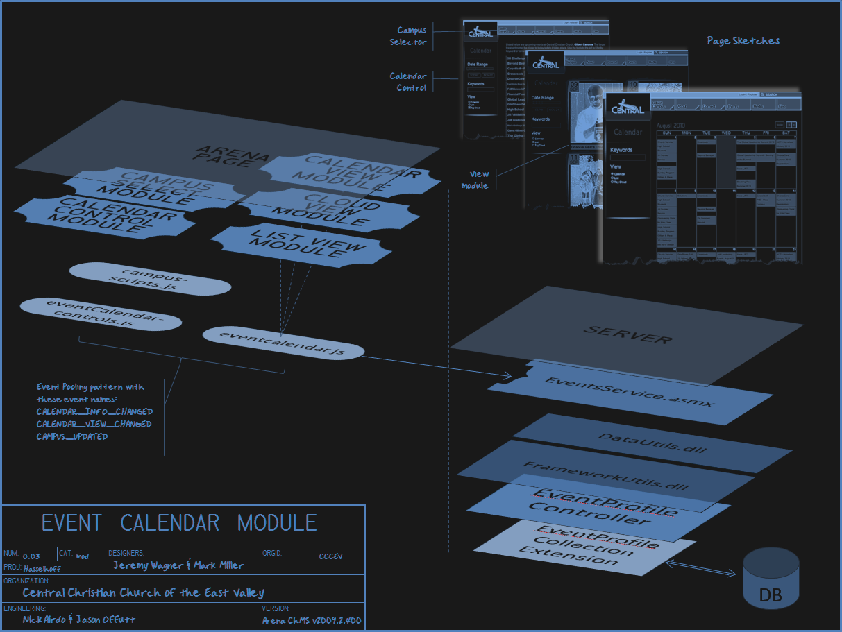

Notes:
Ok, it looks more complicated than it is.

Slide 9
Web Service from – WebServices/Custom/Cccev/Web2/PromotionService.asmx
[WebService(Namespace = "http://www.cccev.com/Arena")]
[WebServiceBinding(ConformsTo = WsiProfiles.BasicProfile1_1)]
[ScriptService]
public class PromotionService : WebService
{
// your web methods go here.
}
Notes:
Flip over to WebServices/Custom/Cccev/Web2/PromotionService.asmx where the real magic is

Slide 10
ASMX vs. SVC/WCF
“The difference in WCF is we program to a specific contract. Here’s the same example above done in WCF.”
“Exposing a WCF service requires a little more training from this point forward …because we have to understand how to configure the service. It is this little bit of extra effort required to understand WCF configuration that stops a lot of developers from using WCF. This is a shame because when the developer using ASMX wants to guarantee message delivery, participate in transactions, or use binary serialization instead of XML, they’ve got a lot of work ahead of them as compared to WCF. ”

Slide 11
Web Service’s Web Methods from – WebServices/Custom/Cccev/Web2/PromotionService.asmx
[WebMethod]
[ScriptMethod( ResponseFormat = ResponseFormat.Json )]
public object[] GetTopicList()
{ LookupCollection topics = new LookupCollection(SystemLookupType.TopicArea); return (from topic in topics.OfType<Lookup>() where topic.Active && topic.Qualifier2 == "true" orderby topic.Order select GetTopicJson(topic) ).ToArray(); }
…
Notes:
Flip over to WebServices/Custom/Cccev/Web2/PromotionService.asmx where the real magic is

Slide 12
Session? No Problem
If you’re client usage is coming from an Arena module you can rely on this:
[WebMethod(EnableSession = true)]
Then you can check the Arena Context as normal: var ctx = ArenaContext.Current; if (ctx.Person != null && ctx.Person.PersonID != -1)

Slide 13
postAsyncJson from - Templates/Cccev/Hasselhoff/js/campus-scripts.js
function postAsyncJson(servicePath, postData, onSuccess, onError)
{ $.ajax({
type: "POST“, url: servicePath, contentType: "application/json; charset=utf-8", data: postData, dataType: "json", success: onSuccess, error: onError
});
return false;
}
Notes:
See UserControls/Custom/Cccev/Web2/js/jquery-arena-promotions.js
We wrapped the standard jQuery ajax call to make it a bit easier
So now we just call postAsyncJson with those four params

Slide 14
Example Usage from – UserControls/Custom/Cccev/Web2/js/jquery-arena-promotions.js
function loadPromotions(topicIDs, areaFilter, campusID, maxItems, documentTypeID, promotionDetailPageID, eventDetailPageID, success, error)
{
postAsyncJson("webservices/custom/cccev/web2/promotionservice.asmx/GetByAreaFilter",
'{ "topicIDs": "' + topicIDs + '", "areaFilter": "' + areaFilter + '", "campusID":' + campusID + ', "maxItems":' + maxItems + ', "documentTypeID":' + documentTypeID + ', "promotionDetailPageID": ' + promotionDetailPageID + ', "eventDetailPageID": ' + eventDetailPageID + ' }',
success,
error);
return false;
}
Notes:
See UserControls/Custom/Cccev/Web2/js/jquery-arena-promotions.js

Slide 15
Example Usage (cont.) from – UserControls/Custom/Cccev/Web2/js/jquery-arena-promotions.js
function onLoadPromotionSuccess(result) { promotions = getPriorityFilteredPromotions(result.d); obj.empty(); $("#" + options.promotionTemplateID).render(promotions).appendTo(obj); obj.fadeIn('fast'); }
Notes:
See UserControls/Custom/Cccev/Web2/js/jquery-arena-promotions.js
More about that “render” call later

Slide 16

Season To Taste
Use a healthy amount of effects to:
Let the user know something is happening
Keep it looking fresh and light
Use pinch of fadeOut() and a dash of fadeIn()

Slide 17



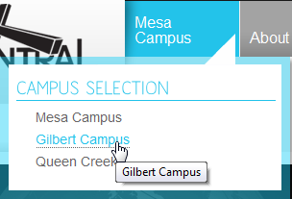
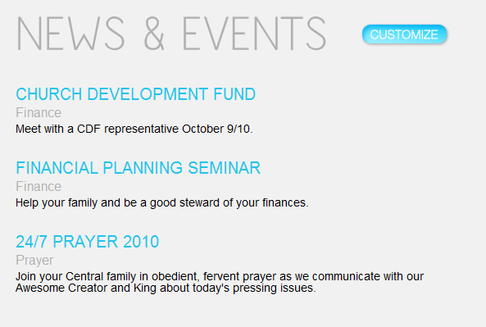
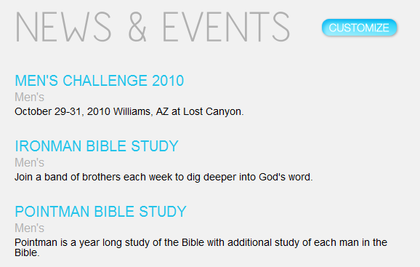
Demo

Slide 18
One more thing…

Slide 19

Event Pooling
A cool and under utilized technique

Slide 20
Event Pooling
A variation of the Observer pattern with jQuery acting as the middle man
Allows you to create some interaction (loose dependency) between modules
Subjects need not know Observers
Uses jQuery “Trigger” and “Bind”
Use your own custom event names
Notes:
We use $(document) because it’s a good global bucket that everything can access.

Slide 21
Trigger()
For example, when someone updates their campus we trigger:
$(document).trigger("CAMPUS_UPDATING");

Slide 22
Our Proposed Custom Events http://community.arenachms.com/Wiki/view.aspx/Proposed_Core_Additions/JQuery_Event_Pooling
CALENDAR_INFO_CHANGED : Triggered when calendar needs to be refreshed/rebuilt.
CALENDAR_VIEW_CHANGED : Triggered when a calendar view has changed.
CAMPUS_UPDATED : Indicates that a person's selected campus has changed.
CAMPUS_UPDATING : Indicates that a person's selected campus is being changed.
CONTENT_RENDERED : Indicates that page content has changed and is ready for post processing. For example, this event would typically be bound to a cufon type module that needs to update the font canvas.
TOPICS_UPDATED : Indicates that a person's selected Topic Areas have changed.
TOPICS_UPDATING : Indicates that a person's selected Topic Areas are being changed.
USER_LOGGED_IN : Indicates that a person's has completed logging into the site.

Slide 23
Bind()
If some module wants to do something when someone updates their campus, it can bind to that event:
// fade out the content area while the campus is updating.
$(document).bind("CAMPUS_UPDATING", function ()
{
obj.fadeTo( "fast" );
return false;
});
Notes:
Here our customized news module fades its contents out
it is also bound to the CAMPUS_UPDATED event

Slide 24
Bind(multiple)
Or respond to several events
// show the news when any of this happens…
$(document).bind("USER_LOGGED_IN CAMPUS_UPDATED TOPICS_UPDATED", function ()
{
showNews();
});

Slide 25
Passing Data & Inspecting Trigger
notice
$(document).trigger(“CAMPUS_UPDATED", [data]);
$(document).bind(“CALENDAR_INFO_CHANGED", function (e, data) {
updateEventListView( e, data);
});
$(document).bind(“USER_INFO_CHANGED", function (e, data) {
updateEventListView( e, data);
});
function updateEventListView( e, params) {
if ( e.type == “CALENDAR_INFO_CHANGED")
postAsyncJson("webservices/custom/cccev/web2/eventsservice.asmx/GetEventList“, '{ "start":"' + params.start.toDateString() + '", "end":"' + params.end.toDateString() + …

Slide 26
References
http://bit.ly/jQEventPooling (Event Pooling)
http://api.jquery.com/trigger/
http://api.jquery.com/bind/
On the Community Wiki
http://community.arenachms.com/Wiki/view.aspx/Proposed_Core_Additions/JQuery_Event_Pooling

